Slide 1
Keep Learning!
My Day

Slide 2
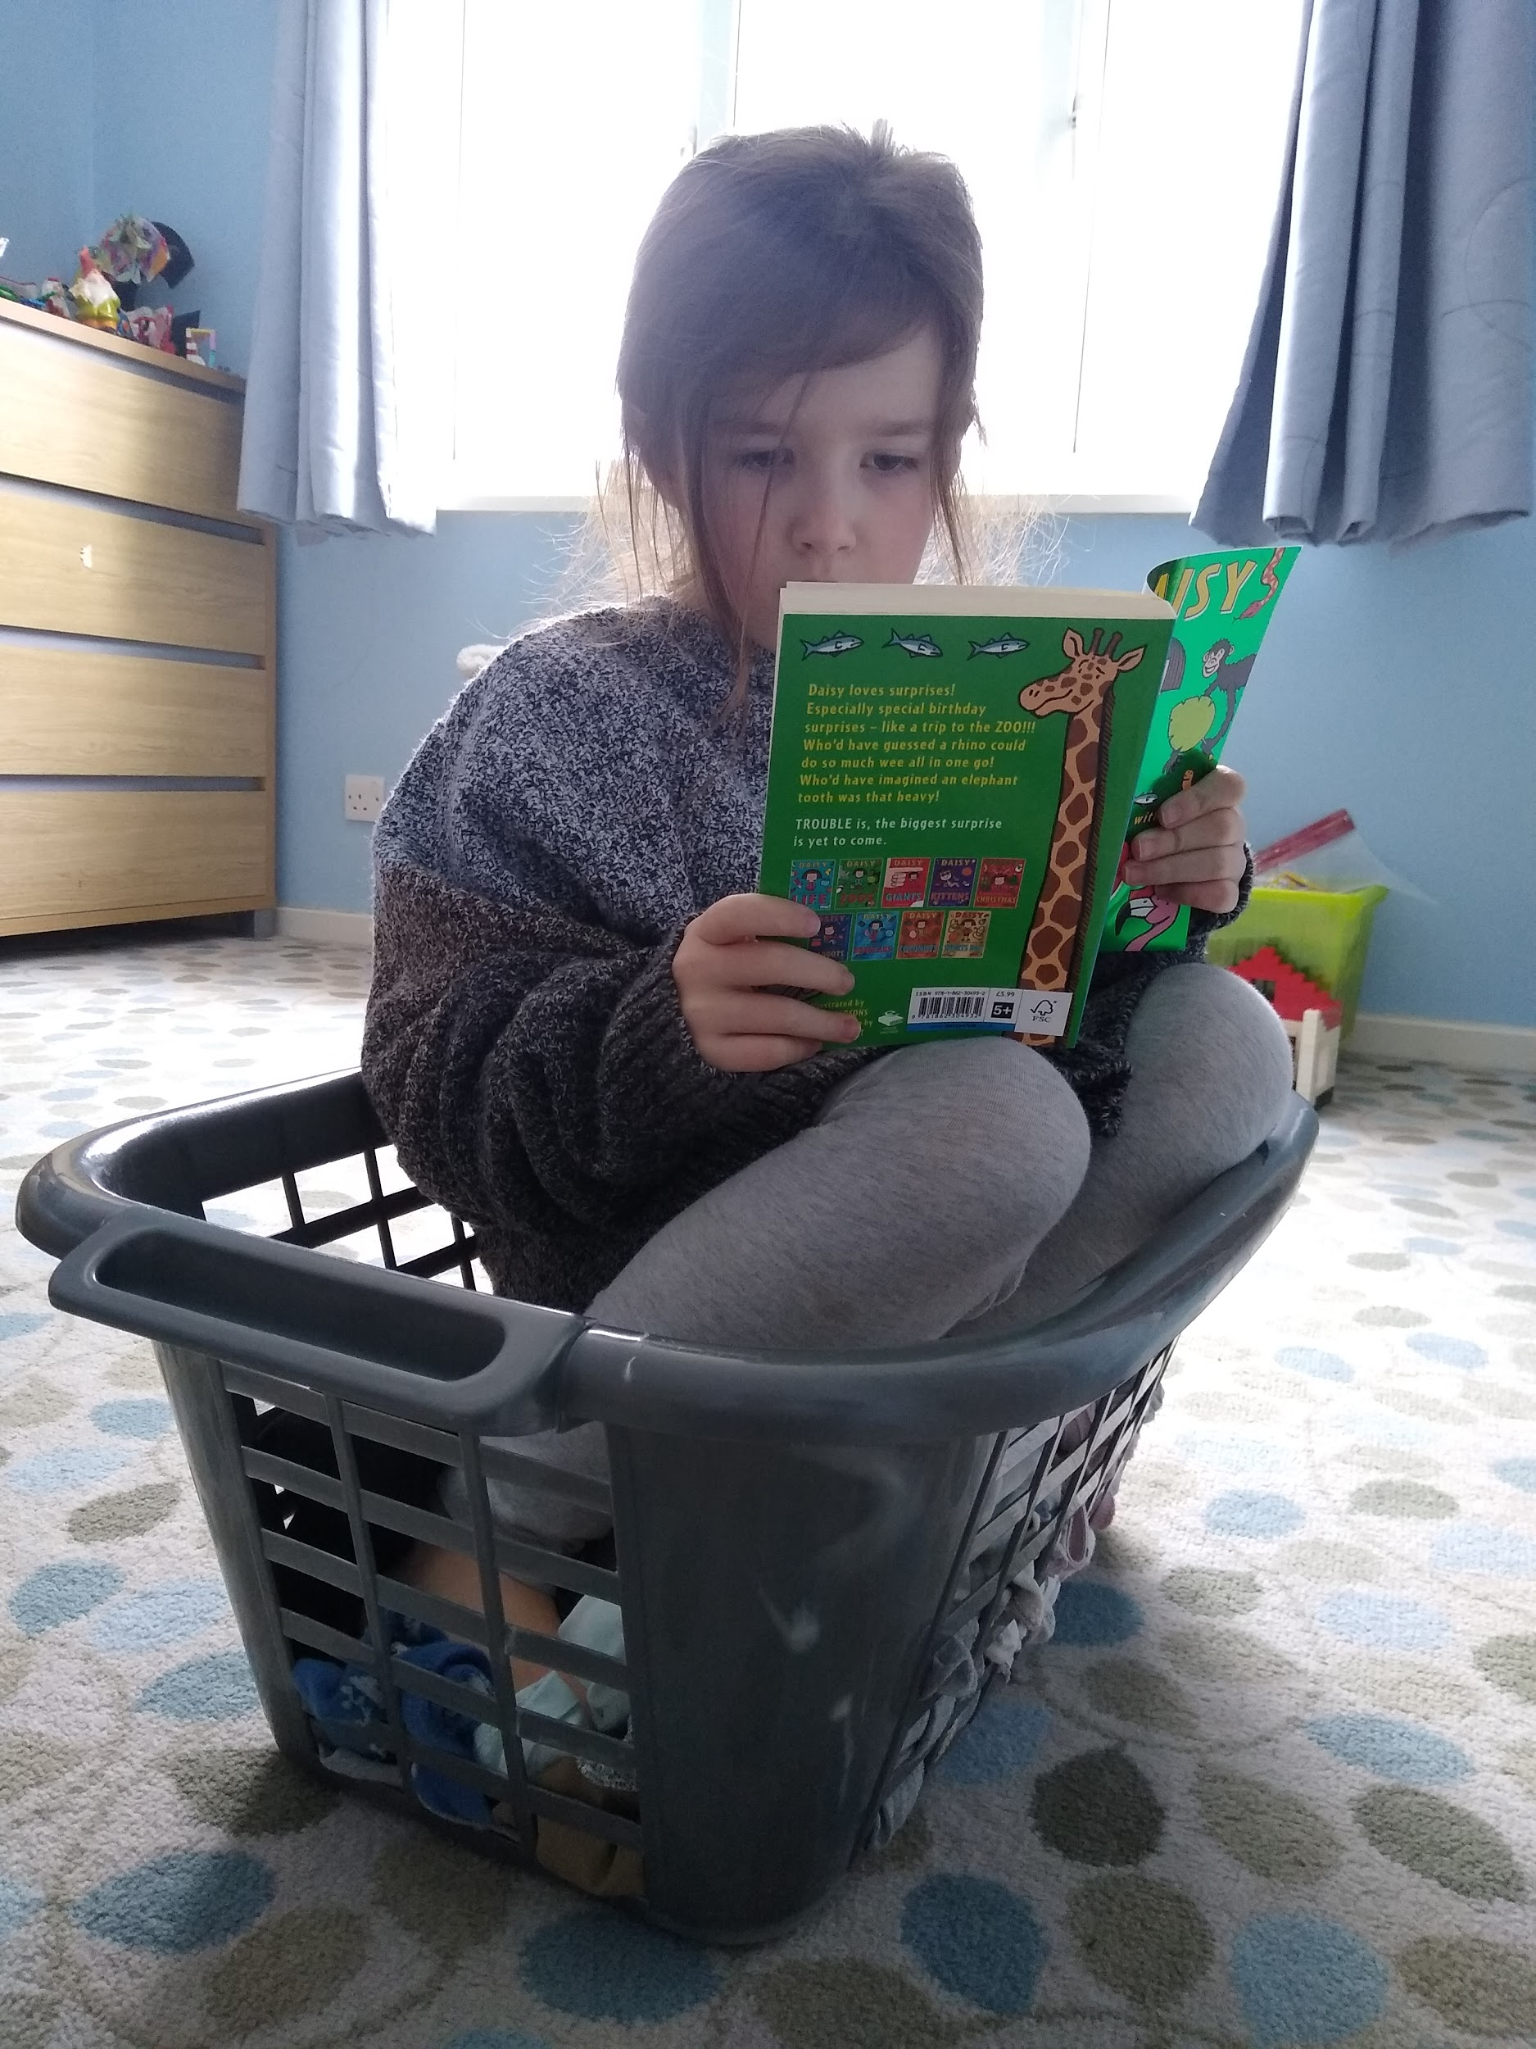
I read a chapter of Daisy and the Trouble With Zoos in a washing basket wearing my daddy’s jumper.

Slide 3
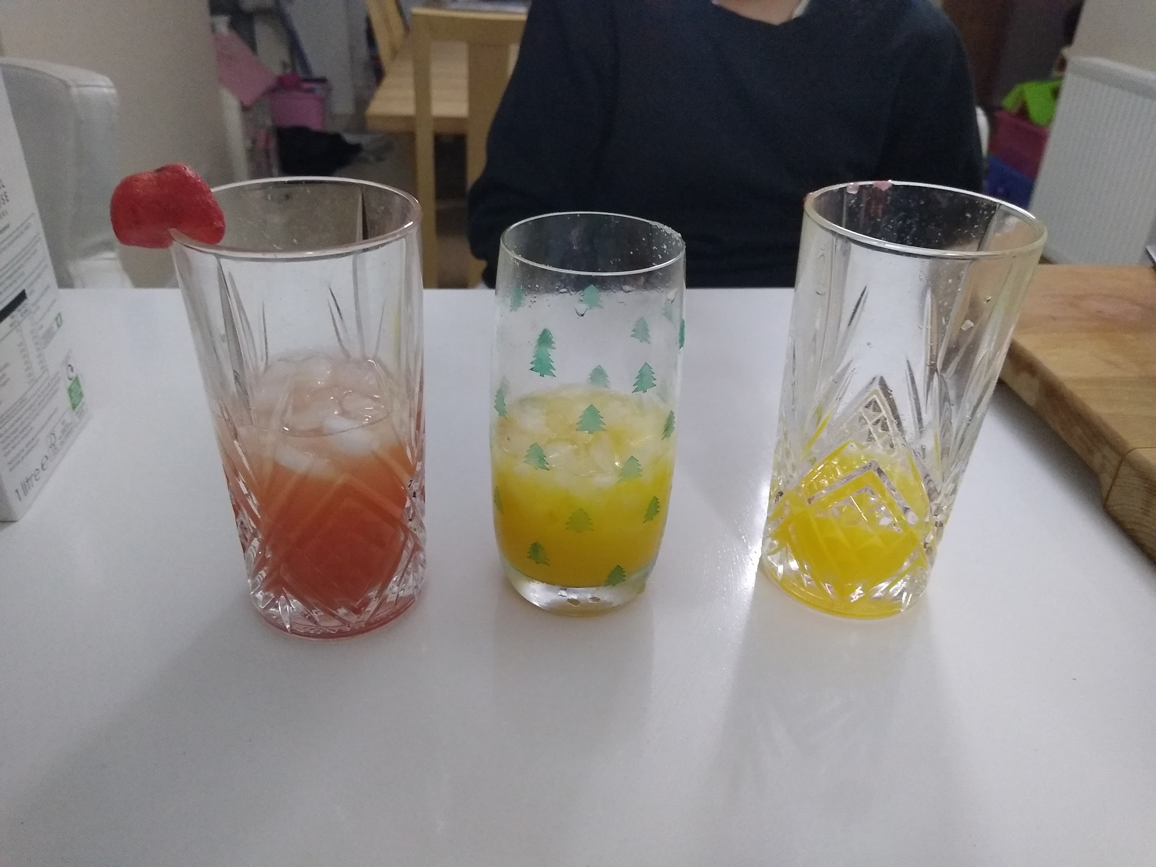
My sister made mocktails and I tried 3 new drinks.

Slide 4
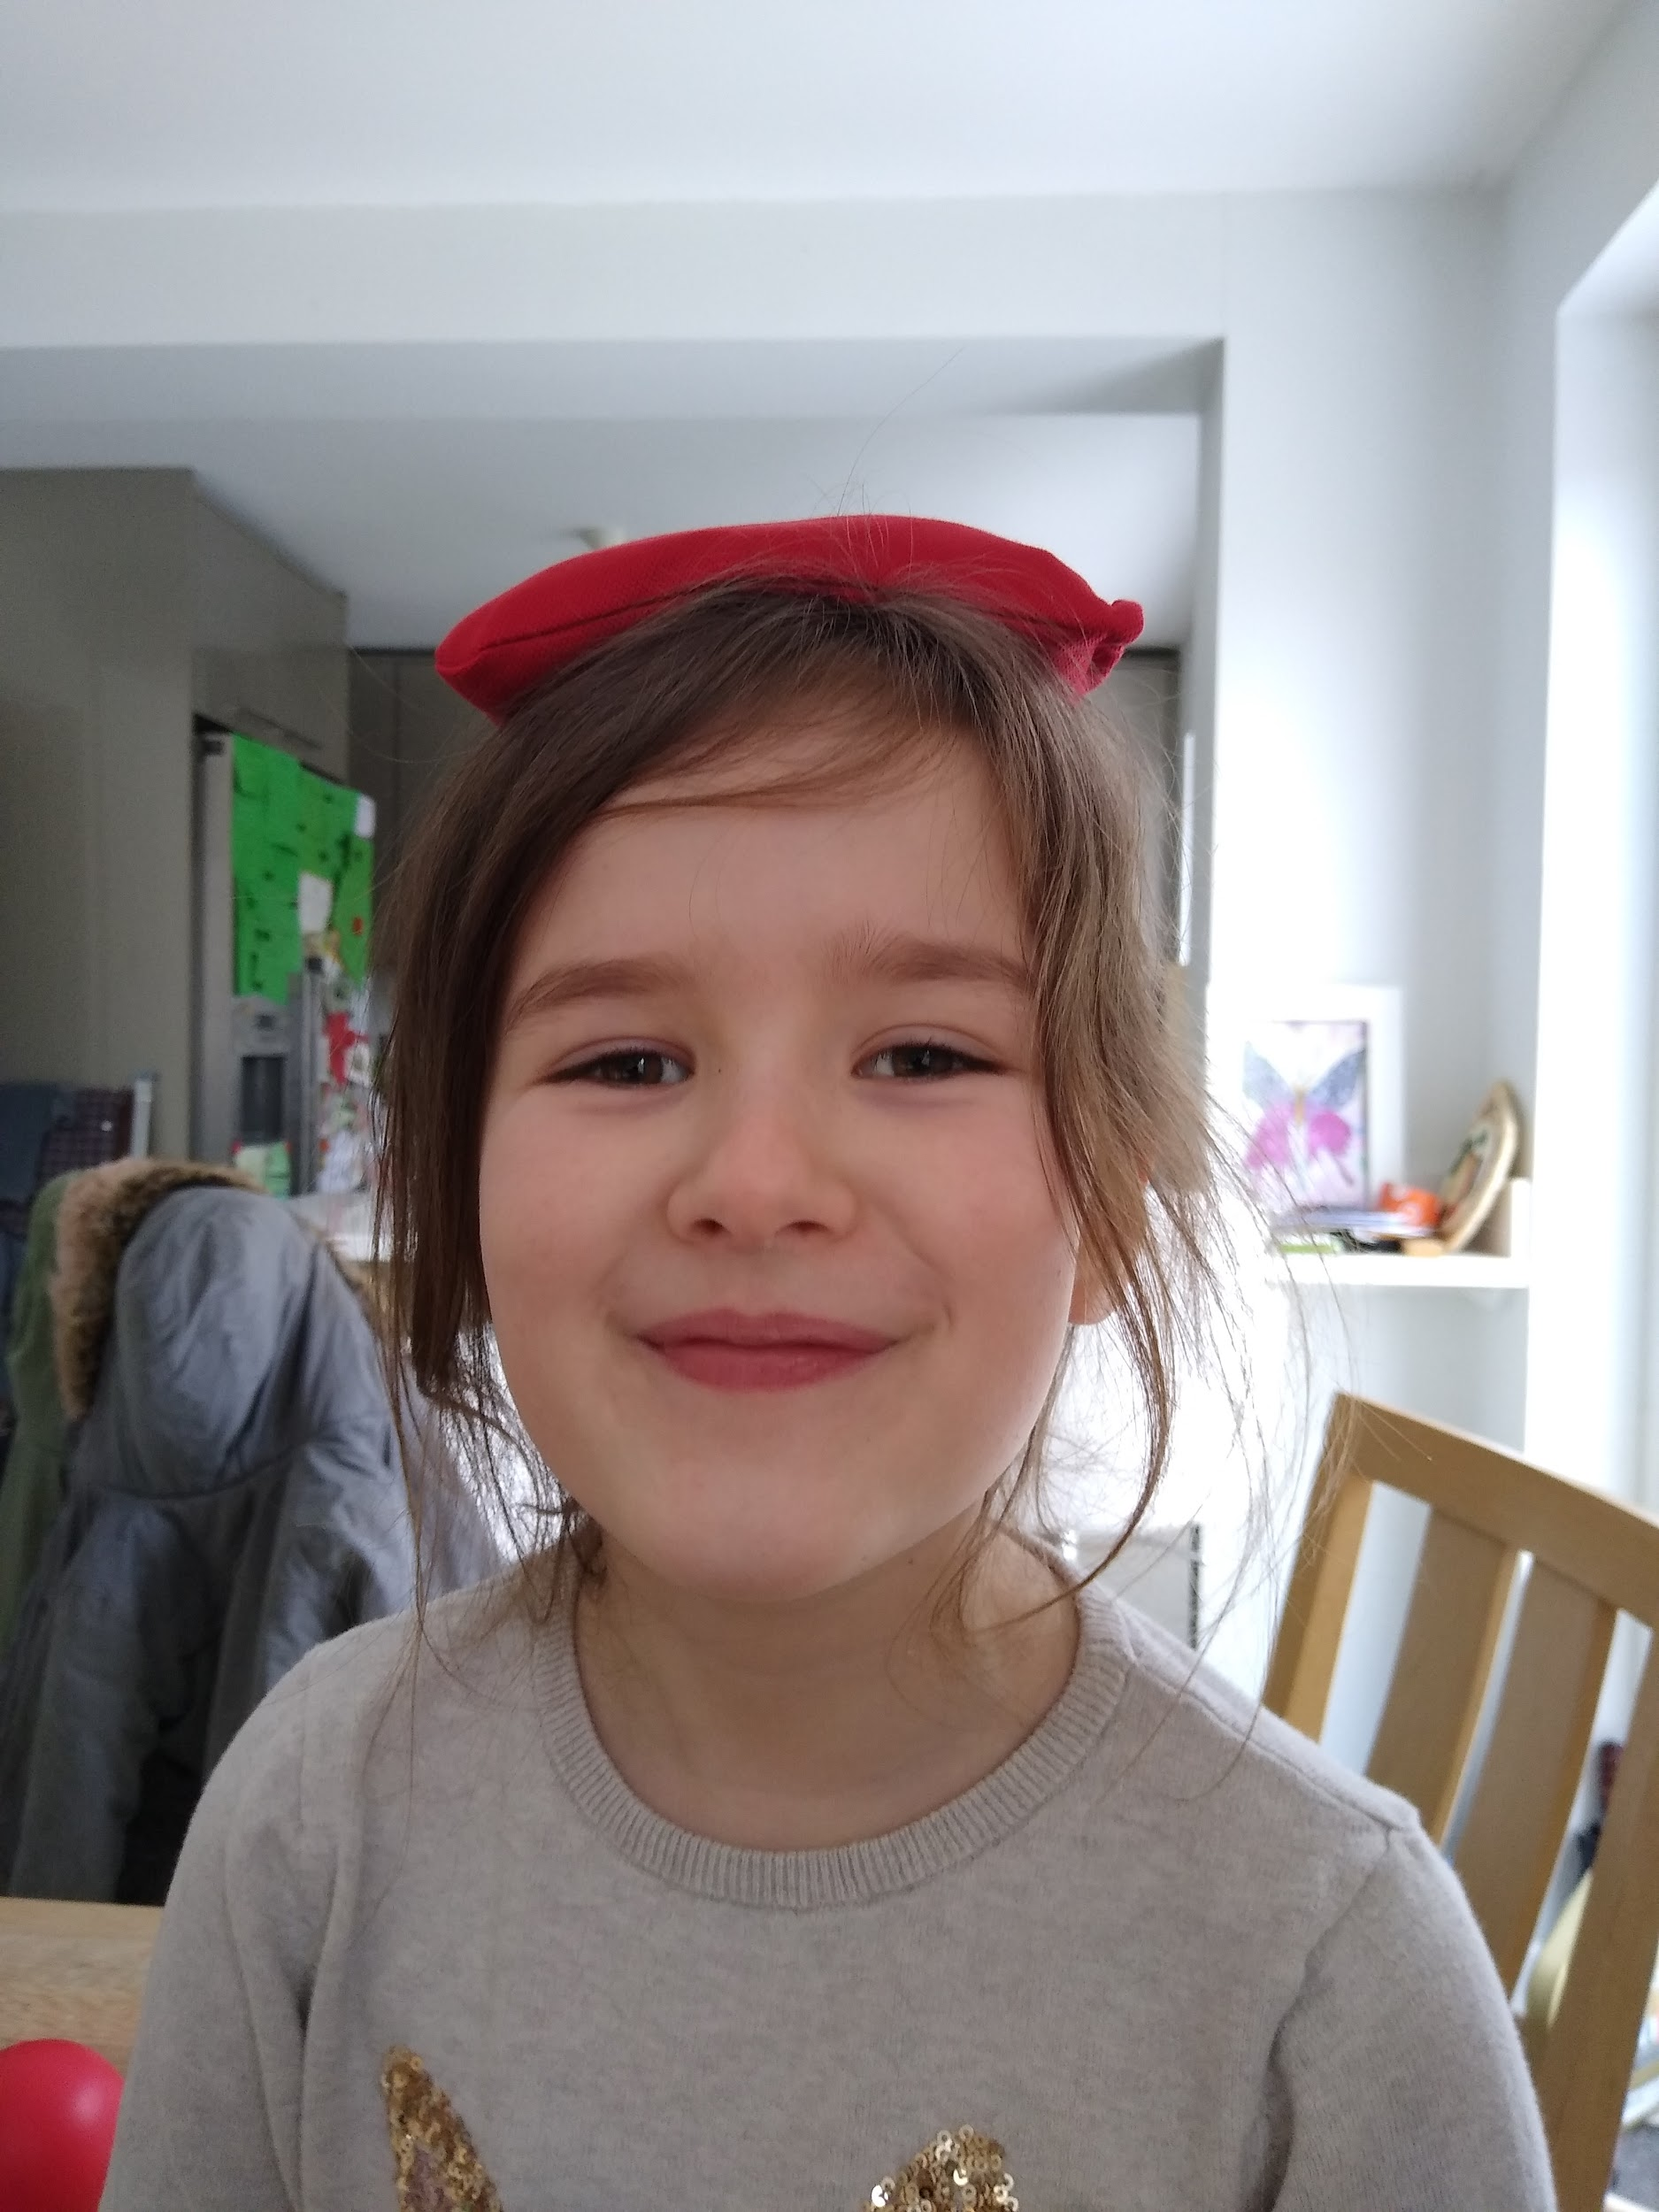
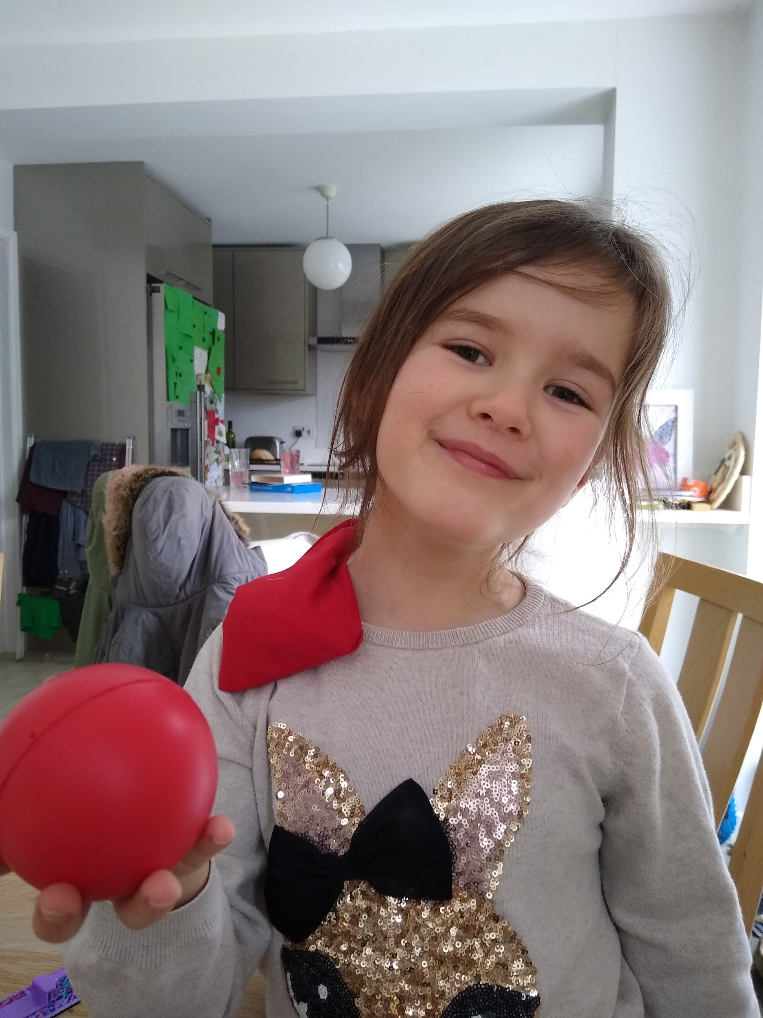
I practiced balancing, throwing and catching.

Slide 5
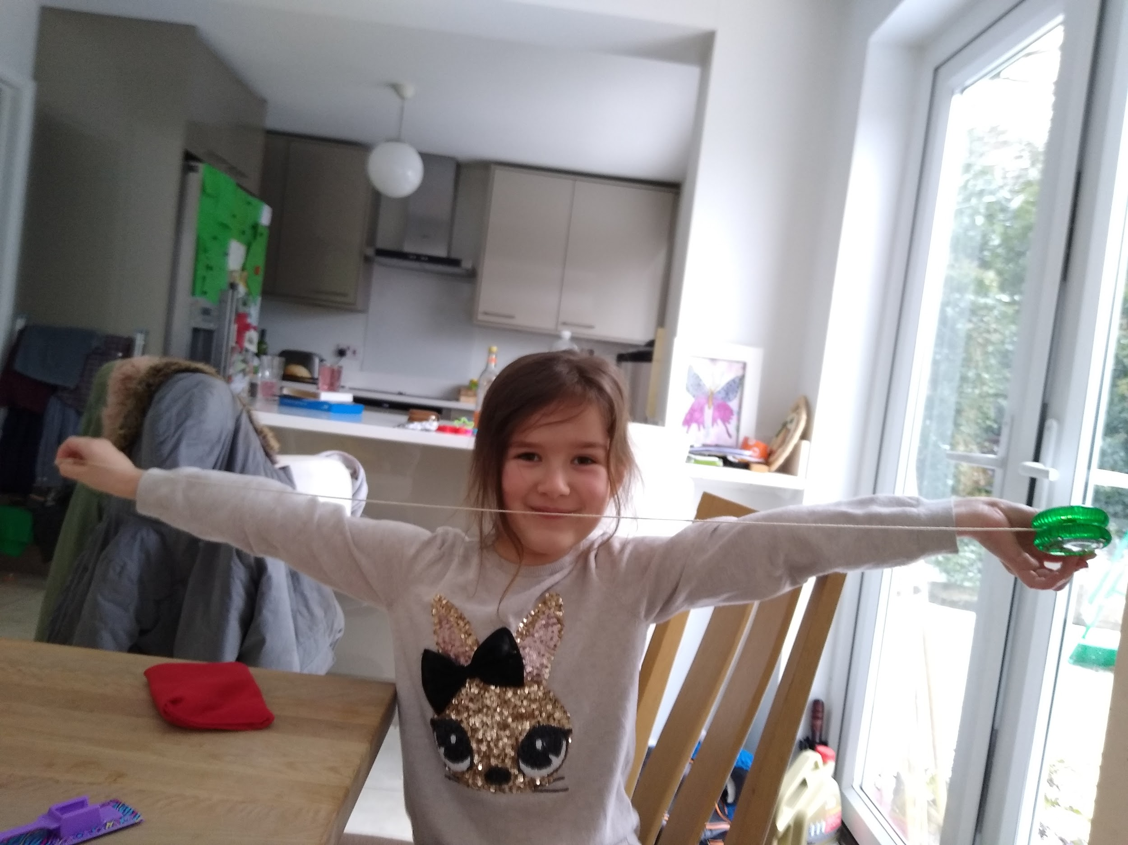
I measured my Mum’s hug. I chose a ruler. It was 171cm long. My Hug was exactly one yoyo (string out).

