Slide 1
MY DREAM HOLIDAY

Slide 2
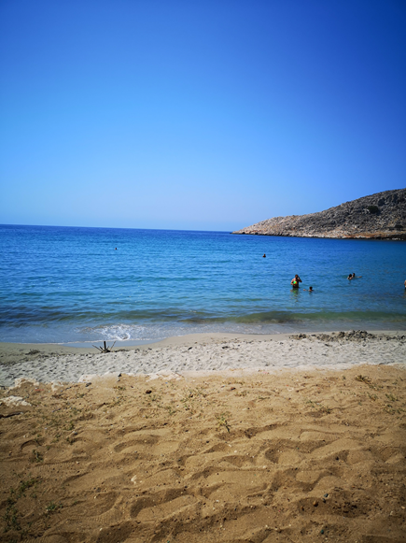
I LOVE RHODES
Rhodes is an island in Greece
It has lovely beaches
The island is1401 km
The population of Rhodes is 119,830 – that’s a lot of people

Slide 3
Last year I went to rhodes
We went in August 2019
That was 10 months ago
We stayed for 10 days

Slide 4
Our hotel
Our hotel had 2 buildings
We had 1 shop in our building
And we had 5 pools all together
There were 2 pools on our side and 3 pools on the other side
We had lots of choices
We used our two pools in the morning and the other 3 pools in the afternoon

Slide 5
BUTTERFLY VALLEY
In Rhodes we went to a butterfly valley
Can you see the butterflies on the tree?
I could not count them - there were too many
Mummy said there may be about a million butterflies!

Slide 6
Statue lady
In Lindos there was a lady who sat very still for a long time
I think she didn’t move for about 30 minutes
To see her, we had to climb up lots of steps – there may have been over 200 steps. We were tired and hot.

