Slide 1
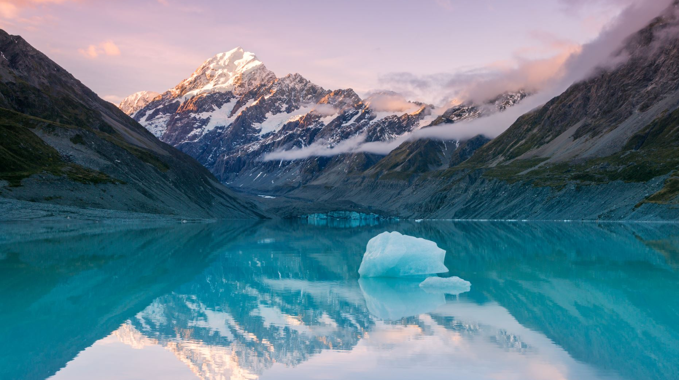
New Zealand
A beautiful country in the Pacific Ocean

Slide 2
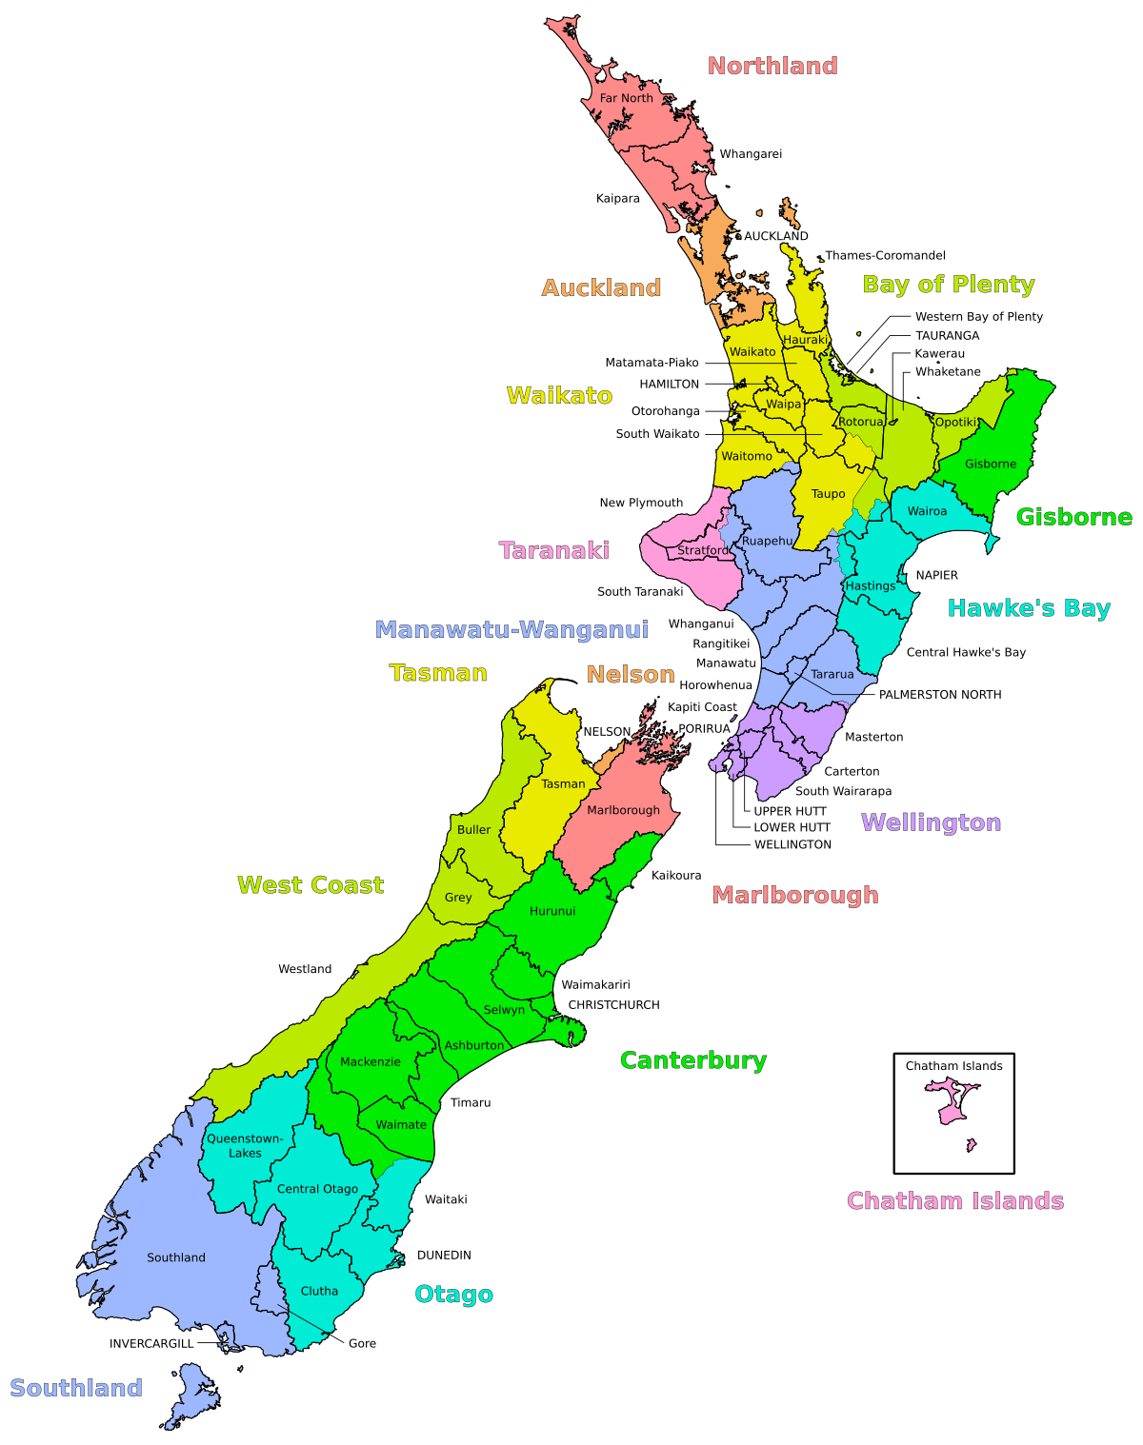
LOCATION & Size
New Zealand is an island country in the Pacific Ocean. It has 2 main islands and 600 smaller islands.
New Zealand is 267,710 Square Kilometres.
The United Kingdom is 243,610 Square Kilometres.
This means New Zealand is 24,100 Square Kilometres bigger than the UK.
New Zealand is 18,390 km from the UK.
It takes 23 hours 48 minutes to fly to New Zealand from the UK. That is almost a whole day!
This Photo by Unknown Author is licensed under CC BY-SA

Slide 3

Time Zone
New Zealand is 11 hours ahead of the UK.
When it is 7am in the UK it is 6pm in New Zealand.
This Photo by Unknown Author is licensed under CC BY

Slide 4
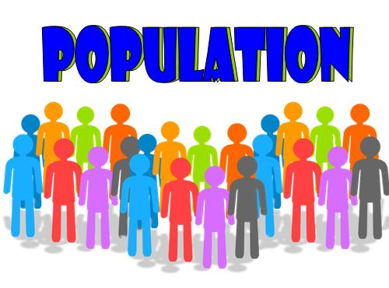
Population
The population of New Zealand is 5,007,400.
The population of the UK is 67,886,004.
This means the UK has almost 63 million more people.
This Photo by Unknown Author is licensed under CC BY-SA-NC

Slide 5


Visitors
New Zealand gets 4 million visitors a year.
The UK gets 41 million visitors a year.
That means the UK gets 10 times more visitors.

