Slide 1
Holiday destinations
By Alice Bartlett

Slide 2
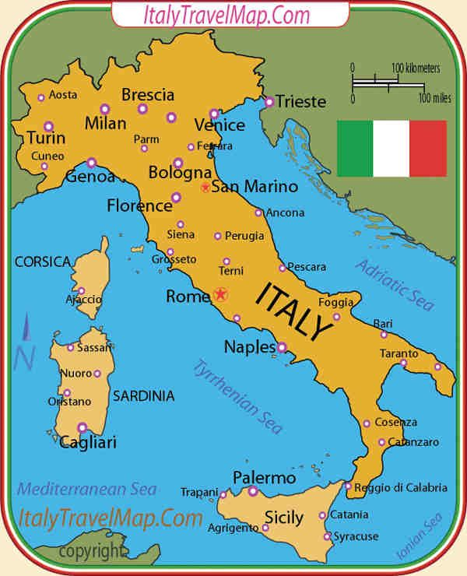
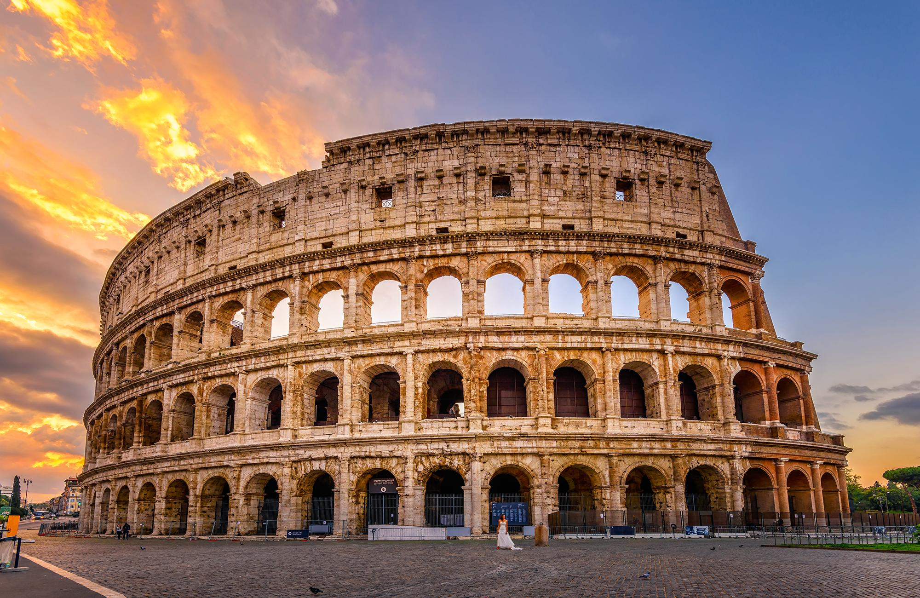
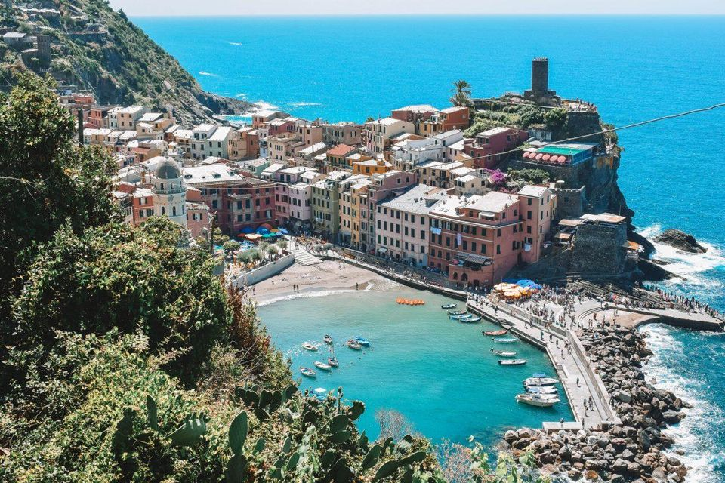
Italy

Slide 3
Facts
Italy is 1900 km away from the UK. Which is 1,900,000m away
Italy is 1 hour ahead of the UK.
It will take around 2hours and 11mins by plane.

Slide 4
Facts 2
There are around 60.36 million people living in Italy.
Around 63.2 million tourists visit each year.
Italy's currency is in EUROs.
1 EURO = 90p.

Slide 5
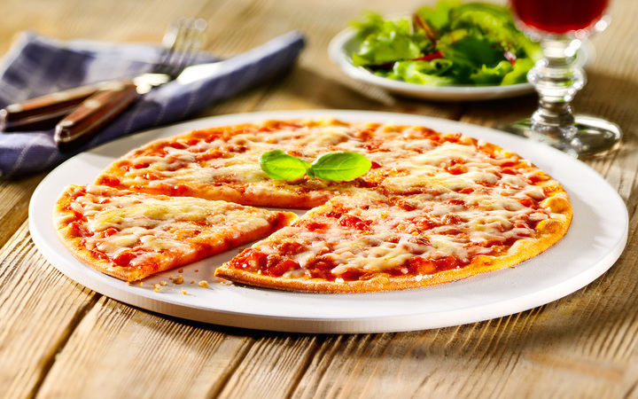
Facts 3
Average price of a pizza in Italy is 4 EURO (£3.60).
Average price of a pizza in the UK is between £10 and £15.

