Slide 1
All about my holiday destination Spain

Slide 2
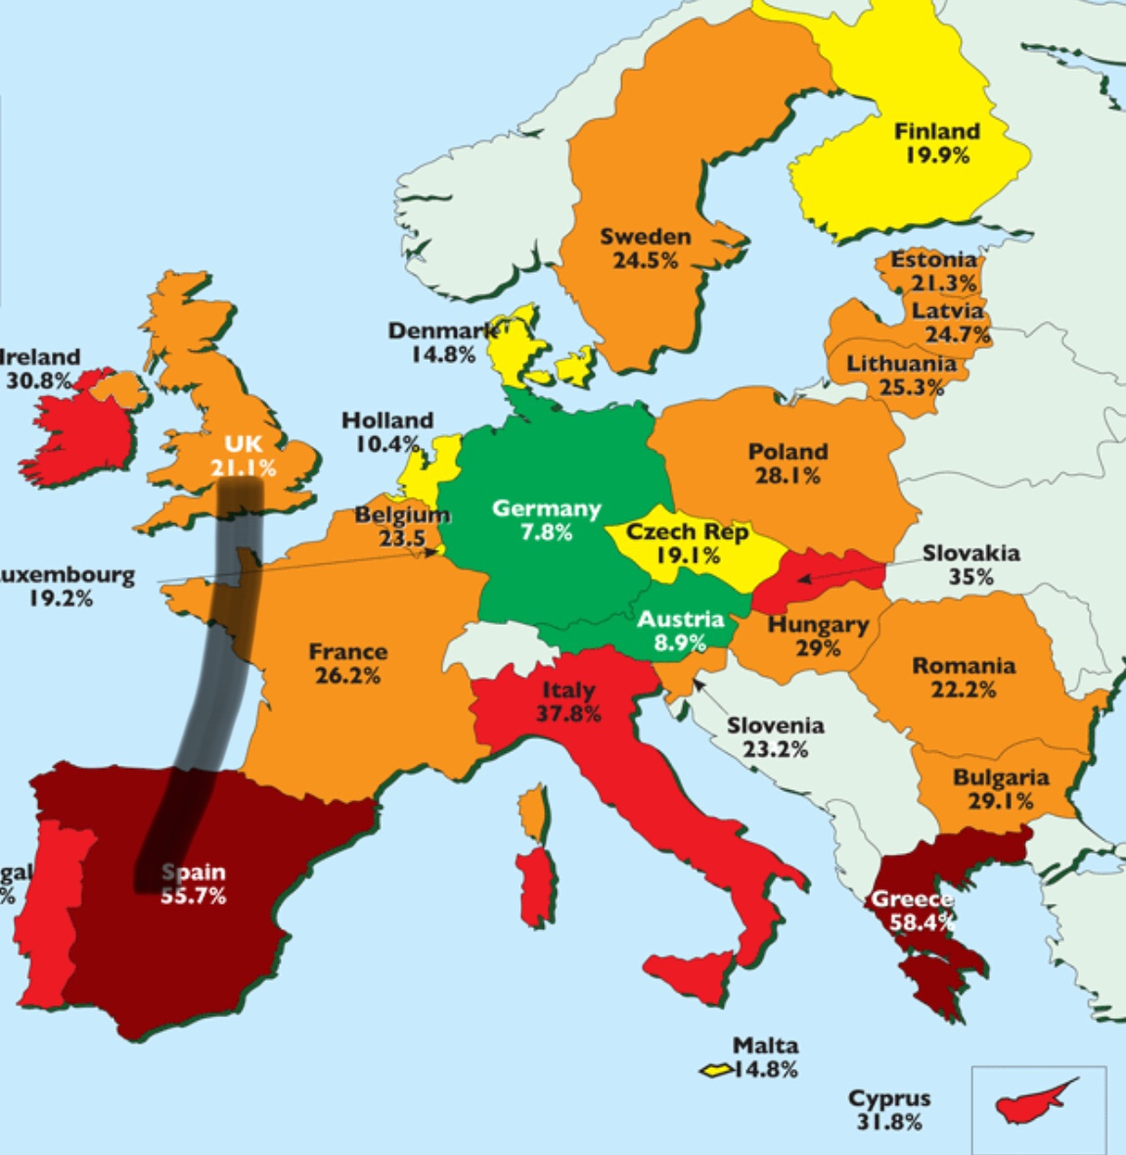
How far away is Spain
Spain is 4,647.39 mi away which is 7,479.25 km away .

Slide 3
What is the time difference
England is an hour earlier than Spain. So if it was 7:00am in England it would be 8:00am in Spain.

Slide 4
How long to get there
By train it takes 14h and 9m
By car 19h and 25m
By plane 2h and 10m

Slide 5
How many people live there
There are 46.94 million people living in Spain.

Slide 6
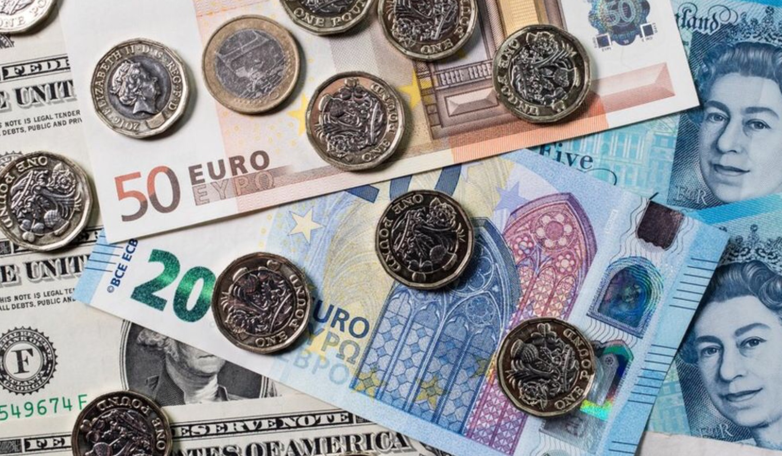
What is the currency
The currency is a Euro. £10 is 11.15 Euros. An ice cream is £2 but in Spain it is 2.23 Euros.

Slide 7
Thank you for watching

