Slide 1
British Values
By Annabel, Caitlyn and Clara

Slide 2
Democracy
The word democracy is a combination of 2 greek root words - Demos and Kratos. Demos means people and Kratos means power or strength. So democracy means Rule by the People.
For the UK, democracy is the right to vote for who governs us.
Democracy is important as without it people wouldn’t be able to share with our Government what they want to happen - like healing the environment or helping the homeless.

Slide 3
Elections
A general election happens at least once every 5 years. People can only vote if they are 18 or older.
You vote to elect a Member of Parliament (MP) to represent the area you live in - your constituency.
There are 650 constituencies across the UK and there are several candidates per constituency.
Most candidates are part of political parties but some are independent.

Slide 4
Political Parties
There are 3 main political parties in England, and also parties that represent Wales, Northern Ireland and Scotland for voters in those countries.
The Conservative Party currently runs the UK Government.
The other two main parties in the UK are The Labour Party and The Liberal Democrats.
Smaller parties include the Green Party, The UK independence Party and People Before Profit.

Slide 5
Being Informed
It is really important to know what the political parties want to do before you vote. People can find out who they want to vote for in many ways:
They can go online - social media, political party websites and news websites are useful.
They can watch television - the news and live debates are good information sources.
They can read the newspaper.
It is important to think about the source of the information you read or listen to as it will not always be factual there will be opinions too!

Slide 6
Votes for Women
Women gained the right to vote in 1918. Before this, only criminals and people in insane asylums and women were not able to vote!
In 1903, Emmeline Pankhurst decided that women deserved the right to vote and started the Suffrage Movement.
Many Suffragettes were sent to prison for what they did, some even died, but after about 15 years women gained the right to vote.
It is really important to vote because people fought so hard to allow women to vote.

Slide 7
Countries without Democracy
Not all countries have democracy.
Saudi Arabia. There, the king rules and makes the decisions. The people cannot vote.
China. The people cannot vote for president. Instead the NPC (National People’s Congress) chooses.
Thailand. The army seized power there and therefore the people have limited power.
In these countries the people have no power and no say over how thier country is run.

Slide 8
Individual Liberty
Liberty means to have freedom from other people's rules and restrictions towards you.
Children have their own rights like:
We have the right to have our own thoughts and opinions on things.
We have the right to choose who we play with.
We have the right to choose what type of healthy snack to bring into school.
Teachers and adults are allowed to restrict certain things to keep us safe but not to control what we do.

Slide 9
What is Individual Liberty in Britain?
Individual liberty is having freedom from restrictions others make including our Government.
What rights do we have?
Individual liberty includes many rights such as:
We have the right to education
We have the right to safety
We have the right to our own beliefs, religion, thoughts and opinions
We have respect for private life and family
We have protection from discrimination
We have protection from slavery

Slide 10
But...
Even though we all have individual liberty that does not mean we are free to do whatever we want.
You still need to obey the law because it keeps you safe and well.
We need to be kind to each other and considerate of others to keep their individual liberty.

Slide 11
Respect
We all deserve respect whether it’s for each other’s property or respect for each other:
listening to others
being kind to others
waiting our turn
following school rules
including others in our activities
using good manners
These are all good ways of showing respect.
We also need to respect ourselves by looking after our bodies and minds.

Slide 12
Resilience
Resilience is bouncing back if things go wrong.
You have to build up resilience.
Keep going
Look at it in a different way
Take a break
Ask for help
Learn from mistakes
Stay calm
See the funny side
Work hard
Be kind to yourself
Doing all these things helps build resilience.

Slide 13
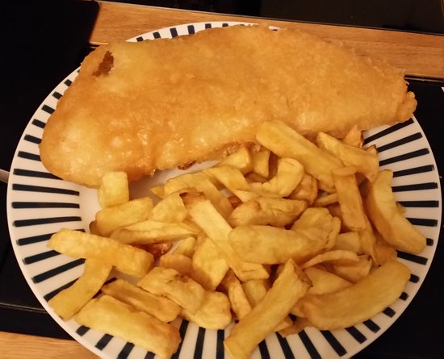
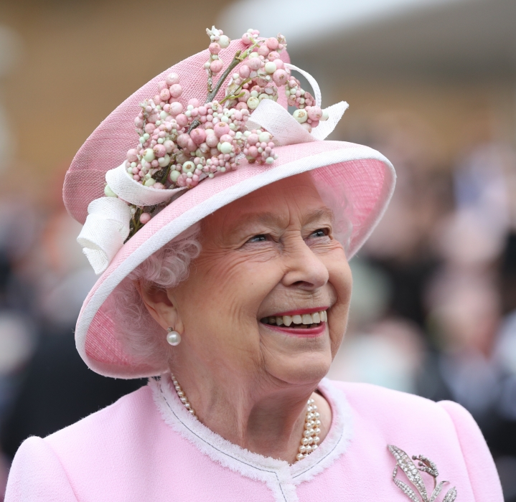
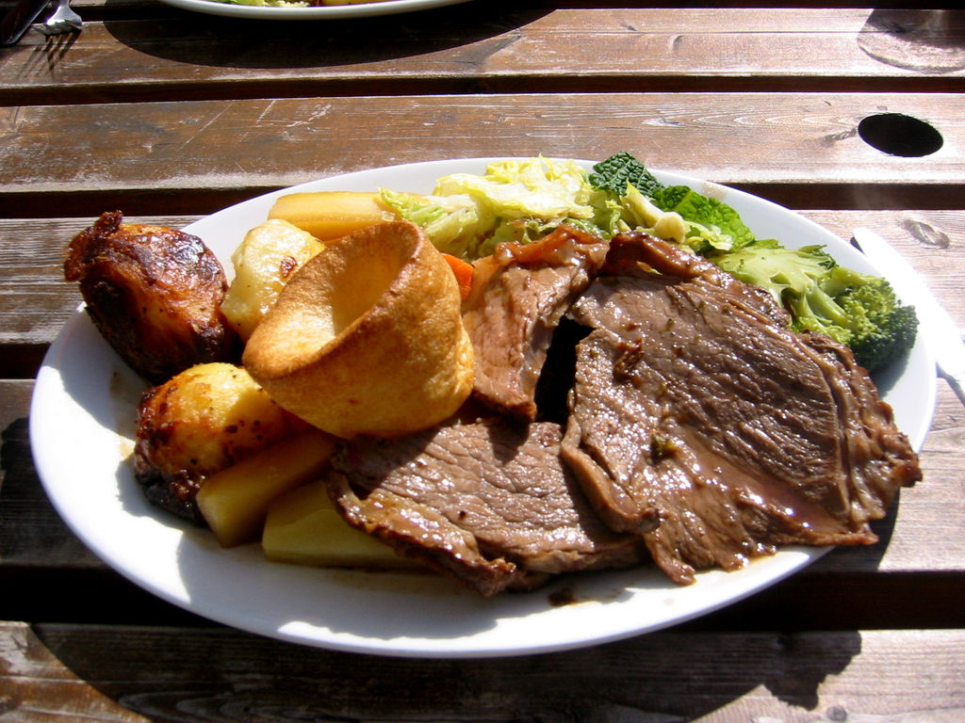
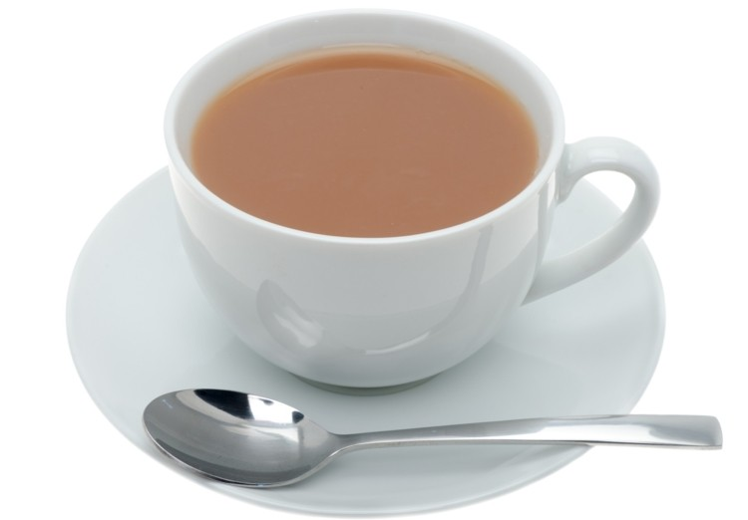
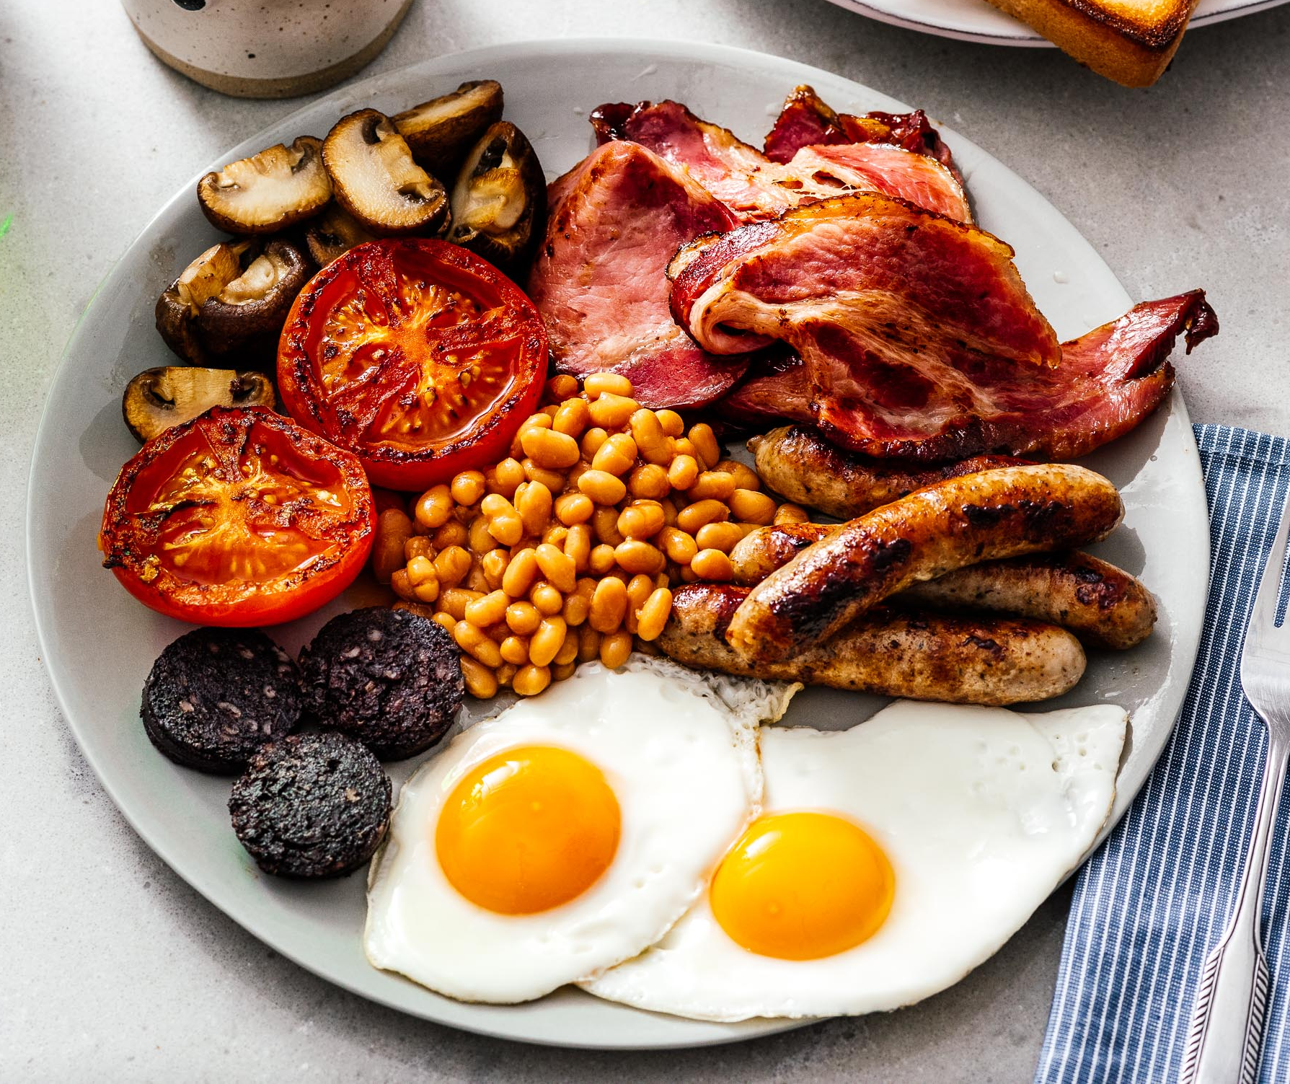
Being British

Slide 14
Thank you for watching!!!

